Slide 1
Python for Beginners
Part 2

Slide 2
What We Learned in Part 1
Python is a great beginner language.
Idle - Integrated DeveLopment Environment
Idle has two modes:
Interactive Mode :
>>> on the screen
responds immediately to commands
Script Mode :
Use File->New File to write a program
We learned Two functions :
print() : prints out a string
input() : asks for input and waits for user to type the Enter key
We learned how to add comments
# this is a human readable comment that Python ignores

Slide 3
What We Are Learning in Part 2
Escape Sequences or How to print the unprintable!
Triple Quoted Strings
Fun With ASCII Art
Variables
Strings
Integers
Floating Point Numbers
Printing & Formatting Numbers
Your Favorite Subject – MATH!

Slide 4
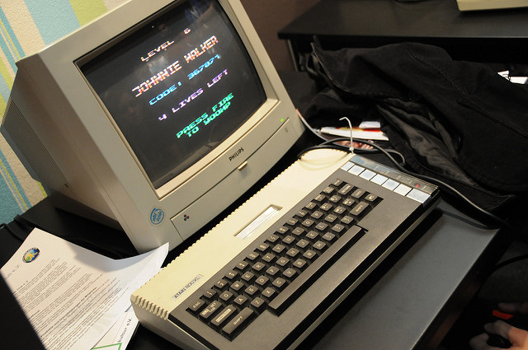
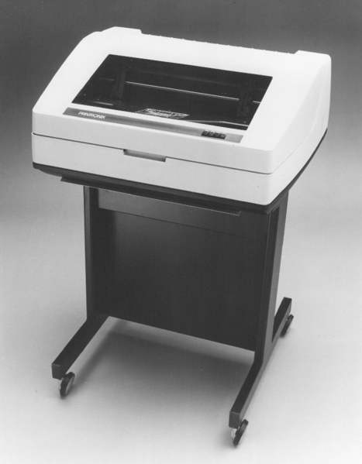
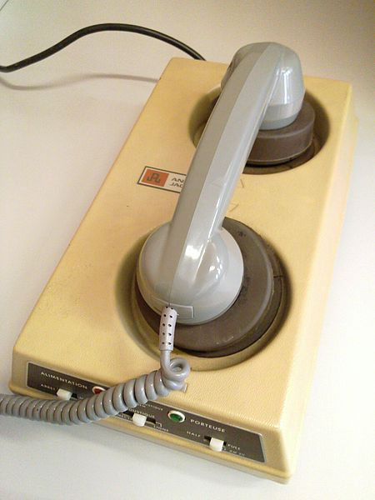
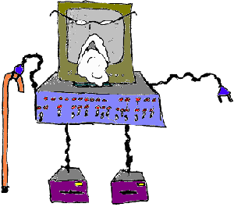
Printing In The Good Ol’ Days

Slide 5
Basic Escape Sequences
\n
Prints on the next line.
\t
Prints a tab.
\a
Makes a bell sound.
(depends on the device)

Slide 6
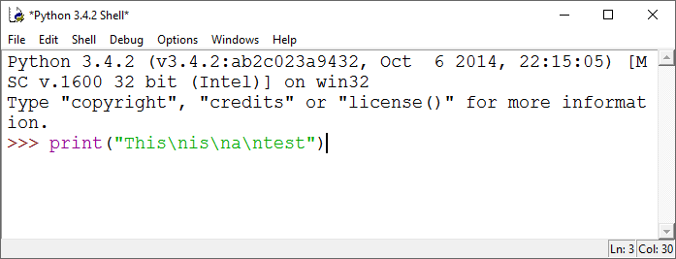
Let’s Try This in the Python Shell
Instead of spaces use \n.

Slide 7
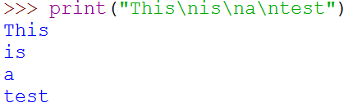
Escape Sequences \n

Slide 8
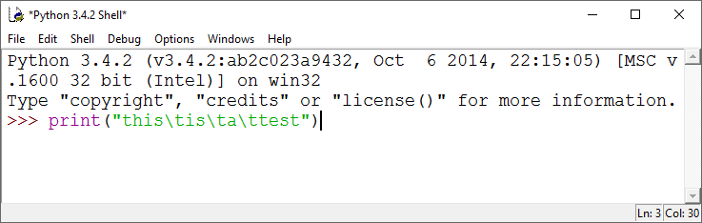
Let’s Try This in the Python Shell
Instead of spaces use \t.

Slide 9

Escape Sequences \t
tabs

Slide 10
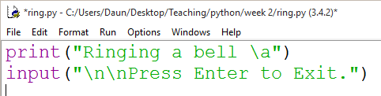
Escape Sequences \a
Type these statements in a script file & save.
Run from Windows folder by double clicking.

Slide 11
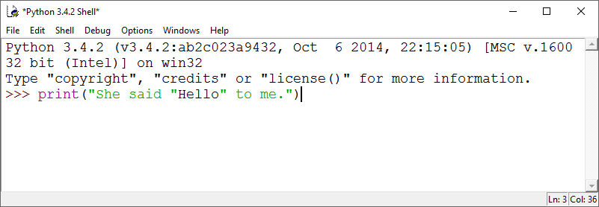
If we use double quotes to indicate a string, then how do we print a quote?
Try This in the Shell… What Happens?

Slide 12
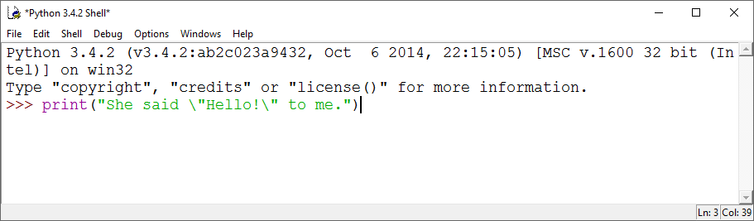
Printing a Quote \”
Try it this way instead!

Slide 13
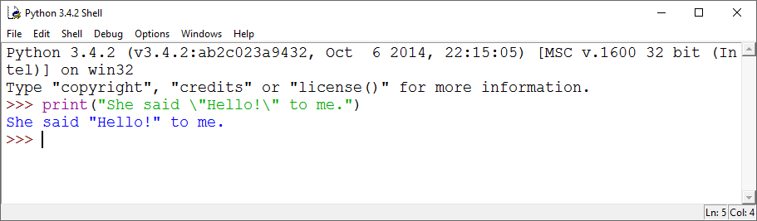
Printing a Quote \”

Slide 14
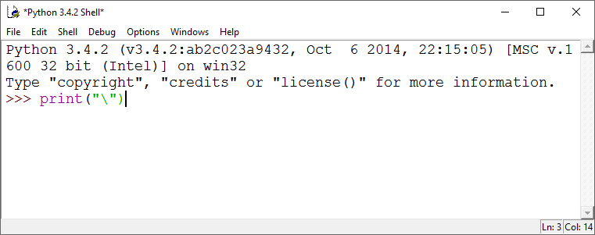
If we use back slashes to indicate an escape sequence, then how do we print a backslash?
Type a print statement with only one(1) backslash in the string argument.
What happens?

Slide 15
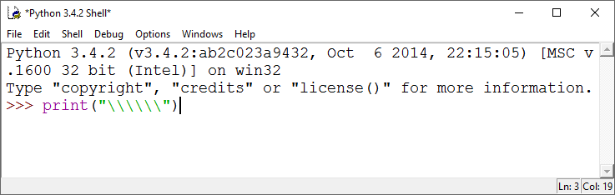
Printing a Backslash \\
Type a print statement with 6 backslashes in the string argument.
How many backslashes actually print?

Slide 16
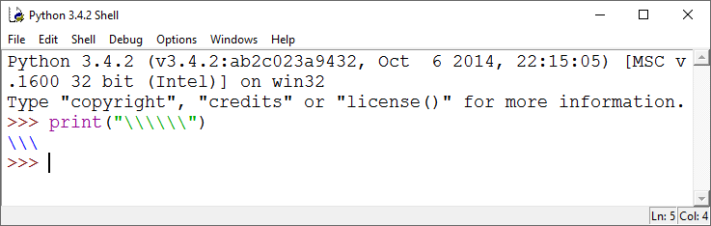
Printing a Backslash \\

Slide 17
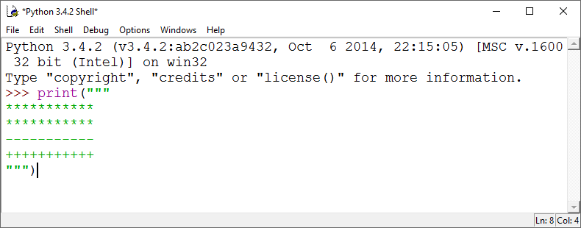
Triple Quoted Strings
Type this …
There are 3 quotes at the beginning and end.
There are 11 of each character.

Slide 18
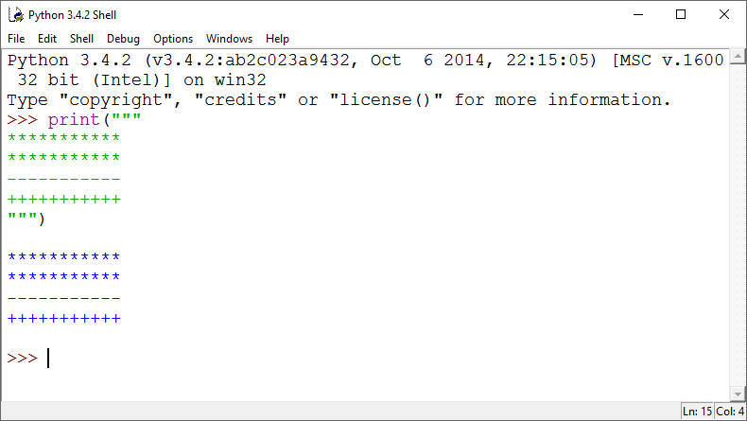
Triple Quoted String
Prints exactly what is between the triple quotes.. even line feeds

Slide 19
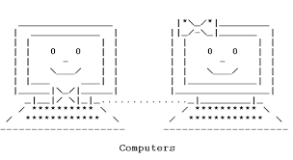
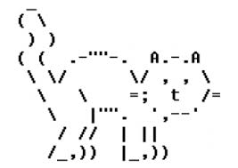
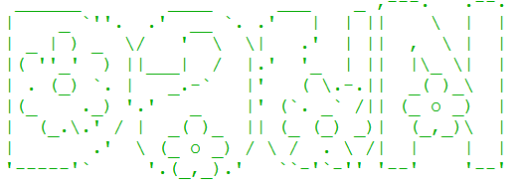

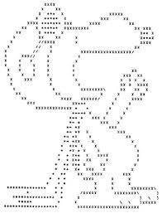
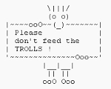
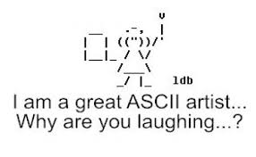
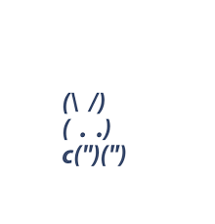
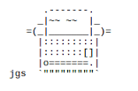
Fun With ASCII Art
ASCII art is a graphic design technique that uses computers for presentation and consists of pictures pieced together from the 95 printable (from a total of 128) characters defined by the ASCII Standard

Slide 20
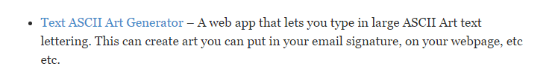
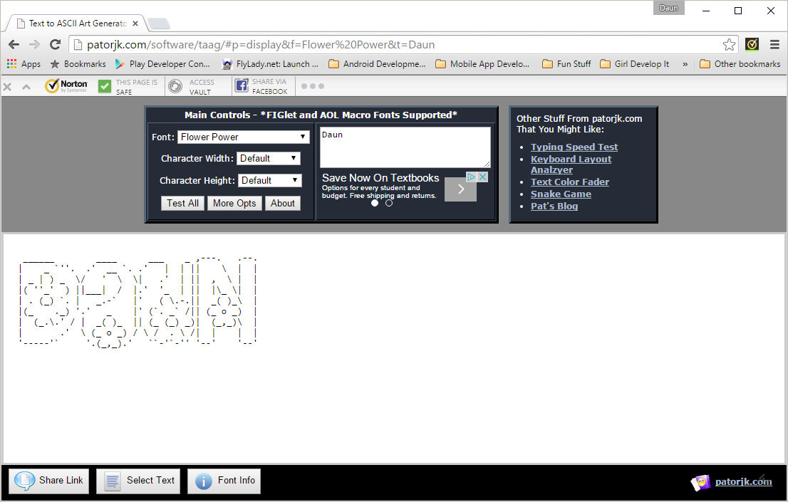
ASCII Art Website (patorjk.com/software)
Select this
To copy

Slide 21
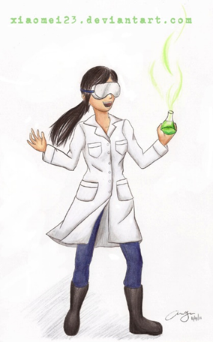
Working Break Time
Use the ASCII Art Generator to create art from your name.
Write a Python Program using triple-quoted strings to prints out your ASCII Art.
(Optional) Have your program ding a bell when printing your name.

Slide 22
Some Functions Return Values
We can “capture” these values and
store them in the computer’s memory.
We store them by assigning the values
to what is called a VARIABLE

Slide 23

Variables
Daun
Value of variable
firstName
Name of variable
This variable holds a string
firstName = “Daun”

Slide 24
Variables
Monty
Value of variable
Name of variable
firstName
This variable holds a string
firstName = “Monty”

Slide 25
Assign variables with =
Monty
This variable holds a string
firstName
firstName = “Monty”
26
This variable holds an int
age
age = 26
75.4
This variable holds a float
height
height = 75.4

Slide 26
What type of variable does input() return?
firstName = input(“Please enter your first name”)

Slide 27
What type of variable does input() return?
firstName = input(“Please enter your first name”)
A String

Slide 28
How do we get an integer from input()?

Slide 29
How do we get an integer from input()?
int()
age = int(input(“Please enter your age :”))
A function inside a function
TRICKY! … Try it!

Slide 30
How do we get an float from input()?

Slide 31
How do we get an float from input()?
float()
height = float(input(“Please enter your height :”))

Slide 32
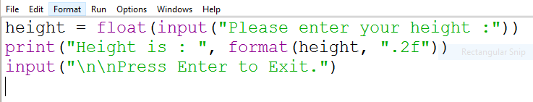
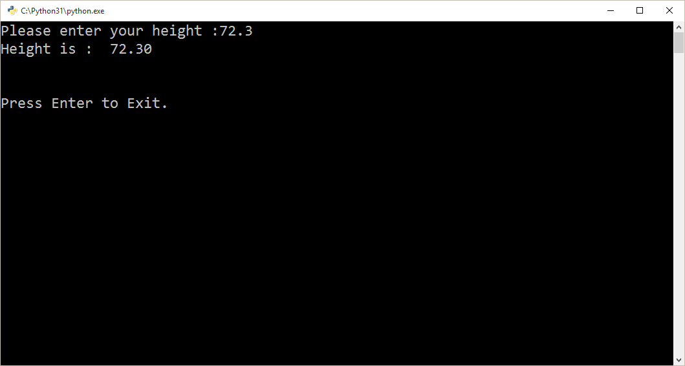
How do we print 2 decimal places?
format(number, “.2f”)
Two decimals

Slide 33
Math
= Assigns a value
+ Add
- Subtract
* Multiply
/ Divide

Slide 34
Math
twoYearsOlder = yourAge + 2
oneYearYounger = yourAge – 1;
evenNumber = number * 2
halfAge = yourAge / 2

Slide 35
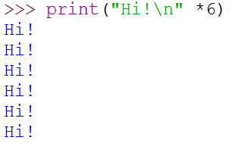
Repeating Strings By Using *

Slide 36
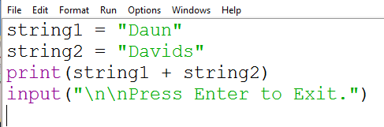
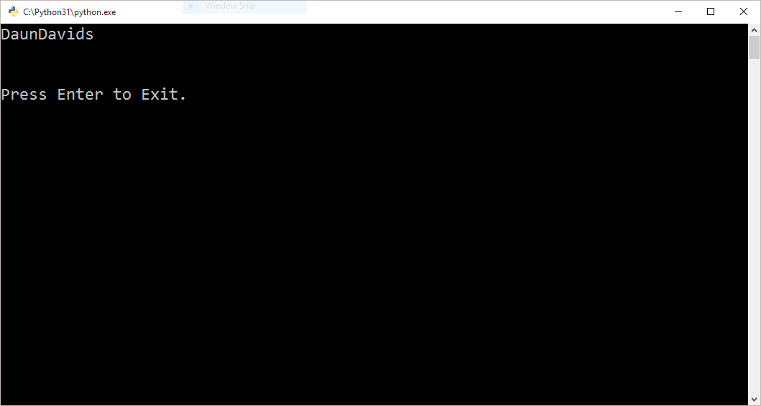
Putting Strings Together (Concatenation)
No Space
+ sign

Slide 37
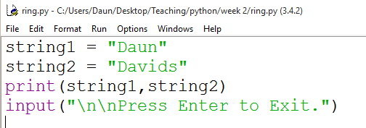
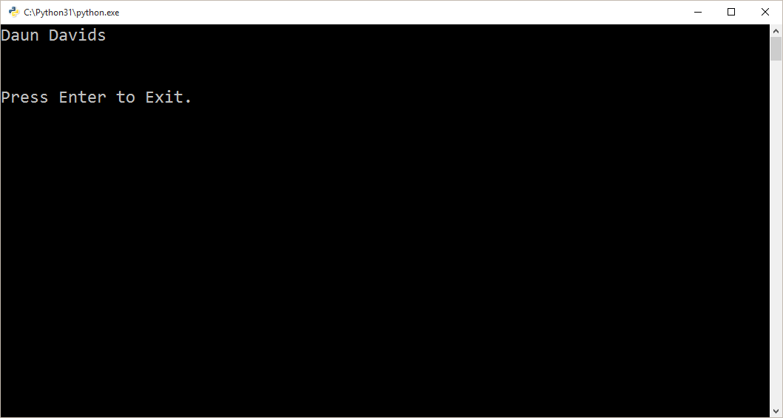
Putting Strings Together (Concatenation)
Has a Space
Comma

Slide 38
ASCII Art Website (patorjk.com/software)
To copy

Slide 39
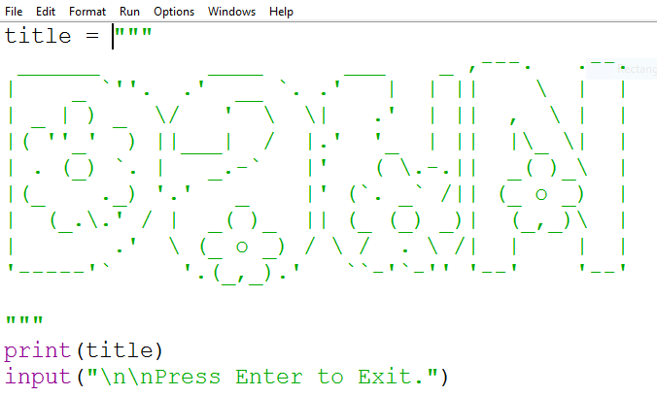
Triple Quoted String Stored as a Variable

Slide 40
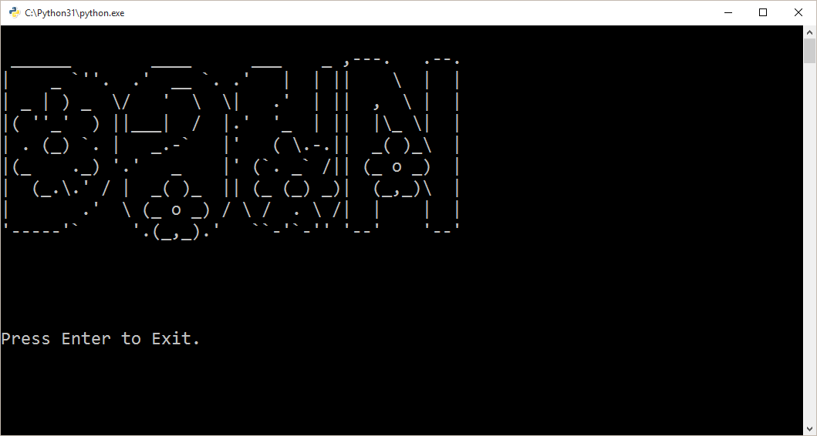
Triple Quoted String

Slide 41
What We Learned in Part 2
Escape Sequences or How to print the unprintable!
Triple Quoted Strings
Fun With ASCII Art
Variables
Strings
Integers
Floating Point Numbers
Printing & Formatting Numbers
Your Favorite Subject – MATH!

Slide 42
Working Break Time
Write your own Python program that uses any ASCII Art stored in a variable.
Google ASCII art generator to find programs that convert images into
ASCII art.

